Slide 1
Electrical
and Electronics science
First year
Computer Science and Engineering
Dr. Shakti Singh
ASSISTANT PROFESSOR
ELECTRCIAL AND INSTRUMENATION
ENGINEERING DEPARTMENT
@shakti.singh@thapar.edu

Slide 2
Field Effect Transistor
FETs are unipolar devices.
Two types of FETs→ Junction FET, Metal oxide semiconductor field effect transistor (MOSFET).
The term field effect relates to a depletion region formed in the channel of a FET as a result of voltage applied on one of its terminal.
FET is a voltage controlled device contrary to BJT, which is a current controlled device.

Slide 3
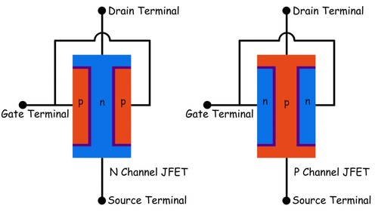
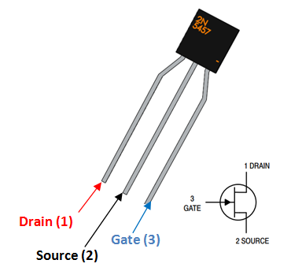
JFET Construction

Slide 4
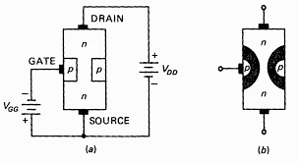
JFET Operation
The JFET is always operated with gate source pn junction reverse biased.
The channel width and thus the channel resistance can be controlled by varying the gate voltage, thereby controlling the amount of drain current.
The junction is wider at the drain end because the reverse bias voltage between the gate and drain is greater than that between the gate and source.

Slide 5
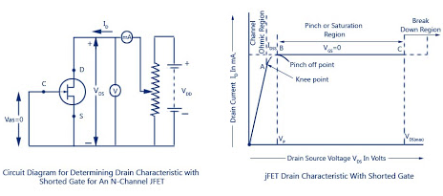
JFET Operation

Slide 6
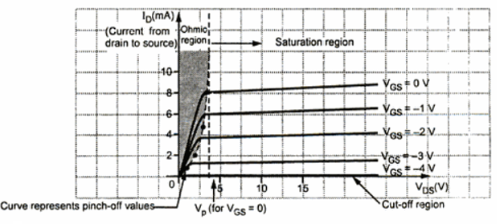
JFET Operation
Pinch off voltage: For V_{GS}=0, the value of V_{DS} at which I_{D} becomes essentially constant is the pinch off voltage. At this value, the maximum drain current occurs and is known as I_{DSS}.
Cut off voltage: The value of V_{GS} that makes I_{D} approximately zero is the cut off voltage.

